Slide 1
How Illinois school staff can Facilitate Access to Health Services: everyone can do something
Funded in whole or in part by:
Illinois Department of Human Services Bureau of Positive Youth Development Division of Family and Community Services
Federal Office of Adolescent Health, Department of Health and Human Services
Notes:
[Introduce yourself/yourselves.]
Today we’re going to do a 15-minute mini-training, also called a Spark, which is intended to “spark” discussion and learning. In this Spark, we’ll focus on the role school staff can play in facilitating access to health services for students – especially when it relates to sensitive topics like sexual health. Sometimes, teachers and other school personnel are uncertain about what they can and cannot say to students about sexual health services – like STD testing and pregnancy prevention – within the limitations of Illinois law and school policies. Hopefully, this discussion will help clarify the issue.

Slide 2
Scenario: mr. brown and james
Image courtesy of ezflexmats.com
Notes:
First, I’m going to read a scenario about an interaction between a Math teacher and a student. As I read aloud, be thinking about ways the adult could handle the situation.

Slide 3
Mr. brown
“I’m a high school Math teacher. One of my students, James, came to me after class yesterday to confide that he is concerned that he might have an STD after finding out that his partner was with someone else at a recent party. He wondered if I knew where he could go for testing. Our school doesn’t have any policies about referring students for those types of services, and I was caught off guard. This isn’t the first time a student has come to me with an issue. I’ve sent others to the guidance counselor, but I recently learned that she calls their parents. James’s parents are very conservative and would be really upset if they found out he was having sex. I told him I would get back with him today. I feel like I am in a bind…”
Notes:
“I’m a high school Math teacher. One of my students, James, came to me after class yesterday to confide that he is concerned that he might have an STD after finding out that his partner was with someone else at a recent party. He wondered if I knew where he could go for testing. Our school doesn’t have any policies about referring students for those types of services, and I was caught off guard. This isn’t the first time a student has come to me with an issue. I’ve sent others to the guidance counselor, but I recently learned that she calls their parents. James’s parents are very conservative and would be really upset if they found out he was having sex. I told him I would get back with him today. I feel like I am in a bind…”

Slide 4
james
“My name is James. It took me a few days to get up the nerve, but I talked to my Math teacher, Mr. Brown, yesterday after class. I told him that I heard Chris was with someone else at a party recently, and I think I should get tested for STDs. We don’t have a clinic in our school so I asked him where I could go without telling my parents. They’d freak out if they knew I was doing that. Mr. Brown said he understood that I needed this to stay private, and said he needed to do some checking to give me the best information. I would have gone to our Counselor, Ms. Wilson, but I heard she calls kids’ parents when they ask about this kind of thing. Mr. Brown has always been someone I trust so I’m sure he’ll be able to help me tomorrow…”
Notes:
“My name is James. It took me a few days to get up the nerve, but I talked to my Math teacher, Mr. Brown, yesterday after class. I told him that I heard Chris was with someone else at a party recently, and I think I should get tested for STDs. We don’t have a clinic in our school so I asked him where I could go without telling my parents. They’d freak out if they knew I was doing that. Mr. Brown said he understood that I needed this to stay private, and said he needed to do some checking to give me the best information. I would have gone to our Counselor, Ms. Wilson, but I heard she calls kids’ parents when they ask about this kind of thing. Mr. Brown has always been someone I trust so I’m sure he’ll be able to help me tomorrow…”

Slide 5
Image courtesy of ezflexmats.com
Notes:
What are your first reactions to this scenario?
[Invite audience to share their thoughts. Possible responses are unsure, uncomfortable, disappointed, concerned. Ask the following questions and allow for brief discussion.]
How realistic is this scenario? Could you imagine this happening in your school?
What do you think the intent of the teacher might be?
What are the possible outcomes in this scenario

Slide 6
THE NEED
Notes:
Many adults feel uncomfortable talking with young people about sex, and some are concerned that talking about it will send a message that they’re encouraging risky behaviors. At the same time, data from the 2015 Youth Risk Behavior Survey show that over one fourth of high school students were sexually active.
Of these teens, 43% did not use a condom the last time they had intercourse, and a full two thirds did not use any form of medically prescribed birth control.

Slide 7
The need
Almost 90% of sexually active individuals age 13 and up have never been tested for HIV.¹
In Illinois…
Over 19,000 teens were diagnosed with chlamydia in 2015.
Cases were diagnosed in every county in the state.
Adolescents ages 15-24 accounted for 66% of all chlamydia infections in 2015.
Notes:
Despite guidelines from the Centers for Disease Control and Prevention calling for sexually active individuals age 13 and up to be tested for HIV, nearly 90% have never been tested, according to the Youth Risk Behavior Survey.
When we look specifically at Illinois, the trends are similar. In 2015, over 19,000 Illinois teens were diagnosed with chlamydia. Cases were diagnosed in every county in the state, with Cook County ranking number 2 in the nation for reported chlamydia infections. Adolescents ages 15-24 accounted for 66% of all chlamydia infections in 2015. This is especially important because chlamydia is a leading cause of infertility.
Connecting teens to services where they can get testing and treatment for HIV and other STDs, as well as effective pregnancy prevention, is vital to improving the health of young people in Illinois.

Slide 8
Sex Education: Important But Not Enough
Notes:
Most schools include some information about sexual health in health classes. However, teens can be “book smart” in the classroom, but they also need to be able to access contraception or STD testing and treatment if they are (or are planning to become) sexually active. Our role as adults is to help them find where they can go to get those needed services.

Slide 9
The private Doctor and Confidentiality
Notes:
Not surprisingly, school staff are most comfortable referring students to their family doctor. However, while minors are legally allowed to receive sexual health services without a parent’s permission, in many health centers, confidentiality is not protected because of the way insurance companies are billed. When private insurance is used, parents receive an Explanation of Benefits statement listing the services the minor received.
It can be difficult to get confidential services in a primary care setting unless the person has Medicaid, which includes some protections for sexual health services, or when a teen receives care at specific health centers whose funding protects minor confidentiality. And we know from research that young people are more likely to seek sexual health services when they have the assurance of confidentiality. If maximum privacy and confidentiality is important to the adolescent, then community-based reproductive health centers, like Title X clinics, offer the maximum safeguards.
Health centers, school staff, and youth-serving professionals can all benefit from learning the basics about what Illinois laws allow or prohibit.

Slide 10
Illinois LAW: true or false?
1.Students age 12 and up have the legal right to access confidential services (like mental health and substance use treatment and sexual health services) without a parent’s consent.
2.A family planning drug or device (including condoms) can be dispensed or prescribed on school grounds.
3.There is no state law that prohibits school staff from making referrals for STD testing and contraception to family planning agencies.
4. There is no state law that prohibits school staff from assisting a student in obtaining an abortion or make referrals specifically for an abortion.
All of these statements are true.
Notes:
Let’s start with a quick quiz to see what you know about Illinois laws. I will be reading four statements. Think to yourself whether you think each is TRUE or FALSE.
[Note: statements are animated to appear one after each click, with the answer showing after the last click. Read each statement aloud before advancing to the next one]
1. Students age 12 and up have the legal right to access confidential services (like mental health and substance use treatment and sexual health services) without a parent’s consent.
2. A family planning drug or device (including condoms) can be dispensed or prescribed on school grounds.
3. There is no state law that prohibits school staff from making referrals for STD testing and contraception to family planning agencies.
4. There is no state law that prohibits school staff from assisting a student in obtaining an abortion or make referrals specifically for an abortion
[Allow a few moments for people to think, then click once more at the end to show the answer—all statements are true.]
All statements on this slide are true. Reflect on this for a moment. What surprises you? Which statement were you least certain about?
[Invite a few audience members to share, then continue.]
It is important to note that while school staff can connect a minor to abortion services, the Parental Notice of Abortion Act in Illinois does require a healthcare professional to notify the parent or guardian 48 hours in advance of the procedure. While parental notification is not the same as requiring parental consent for the procedure, this is important to keep in mind when having conversations about abortion with minors.
Here is a handout that explains some of the key Illinois laws in greater depth. Feel free to reference it later if you have more questions.

Slide 11
THE law in action
1. Are teachers required to work through school counselors or nurses to give students referrals to outside agencies?
2. Is the school counselor or teacher required to tell the parents if a student discloses that they are sexually active and would like to get birth control?
3. Would a school counselor or teacher be allowed to tell a student where they can get contraception?
4. Can a health teacher do a condom demonstration?
NO
NO
YES
YES
Notes:
Let’s apply the law to some specific situations.
[Click through the slides so that the questions and then answers appear.]
Are teachers required to work through the school counselor or nurse to give students referrals to outside agencies? Answer: NO
2. Is the school counselor or teacher required to tell the parents if a student discloses that they are sexually active and would like to get birth control? Answer: NO
3. Would a school counselor or teacher be allowed to tell a student where they can get contraception? Answer: YES.
4.Can a health teacher do a condom demonstration? Answer: YES
To recap, teachers and any other school personnel may make referrals for any sexual health services to teens without parent permission or notification.

Slide 12
Important considerations
Notes:
It’s always best to encourage students to talk to their parents or other trusted adults about these issues. A school staff person can talk with the student about what that might look like and offer to be a part of the conversation.
There may be situations, however, where the student is adamant about not wanting their parent to know. In those situations, our first instinct is to refer to a counselor, school nurse, or a school-based health center.
And that makes sense, because these school professionals may have more training and often more comfort in these areas.
BUT...students may not feel comfortable, have a rapport, or have easy access to these professionals. So ultimately everyone in the school needs to be informed and have the knowledge and skill to make referrals.

Slide 13
We All Play a Part
Notes:
No matter what your role, whether a teacher, counselor, nurse, administrative assistant, principal, or other role, you can help students access the health services they need. Most of us do this because we care about kids and we want them to be healthy and supported.
Students tend to come to a school staff person for a reason. It’s because they trust you and it often takes a lot of courage for them to confide in you. We want to make sure that all of you have the information, comfort, and resources to make the connection for students.

Slide 14
HOW WE CAN HELP
1. Maintain a list of providers
2. Identify “go to” people in building
3. Post PSA materials in visible areas
Notes:
Here are some things that we have seen other sites use effectively in their schools.
•Develop a list of providers and resources that young people may need to access confidential health services.
•Identify staff in the building who are the “go to people” for helping students identify and access needed providers.
•Utilize student-developed posters or other PSA materials in highly visible areas.
What other ideas do you have?

Slide 15
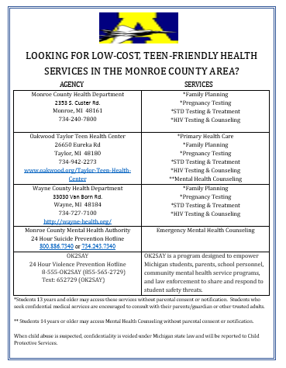
Referral list
Updated regularly
Visible to all staff and students
Available for parents
Notes:
A referral list can be a really helpful tool. Develop a list of providers and resources that young people may need to access confidential health services (e.g., suicide prevention, substance use, sexual assault, STD testing and treatment). The list can be vetted by school leaders and community partners. The list is only effective if people know about it and can easily access it!

Slide 16
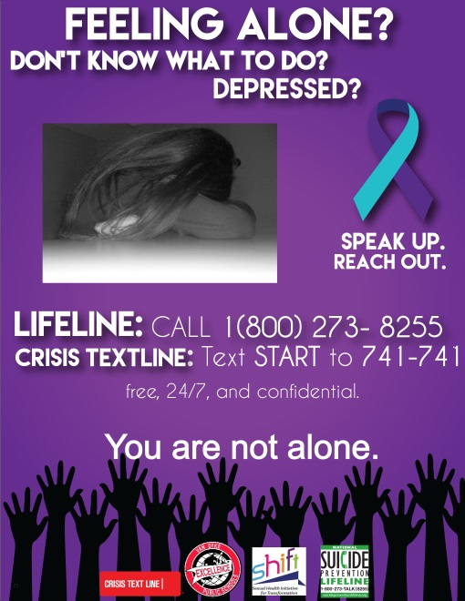
Posters
Notes:
Student-developed posters or other awareness materials can be put in bathroom stalls or other highly visible areas. These posters can be about a number of health-related topics, including sexual health. What other ideas do you have?

Slide 17
HOW will we HELP?
Which strategies would be most realistic in our school?
Which strategies might have the biggest impact?
What would need to be in place for this to happen?
Notes:
Let’s close with a think-pair-share discussion. Turn to the person sitting next to you, and discuss what role you could play.
Discussion Prompts:
•Which strategies would be most realistic in our school?
•Which strategies might have the biggest impact?
•What would need to be in place for this to happen?
[Give participants a little time to discuss. If time report out.]

Slide 18
Thank you!
Notes:
Are there any remaining questions?
Thank you for participating today!

