Slide 1







Slide 2

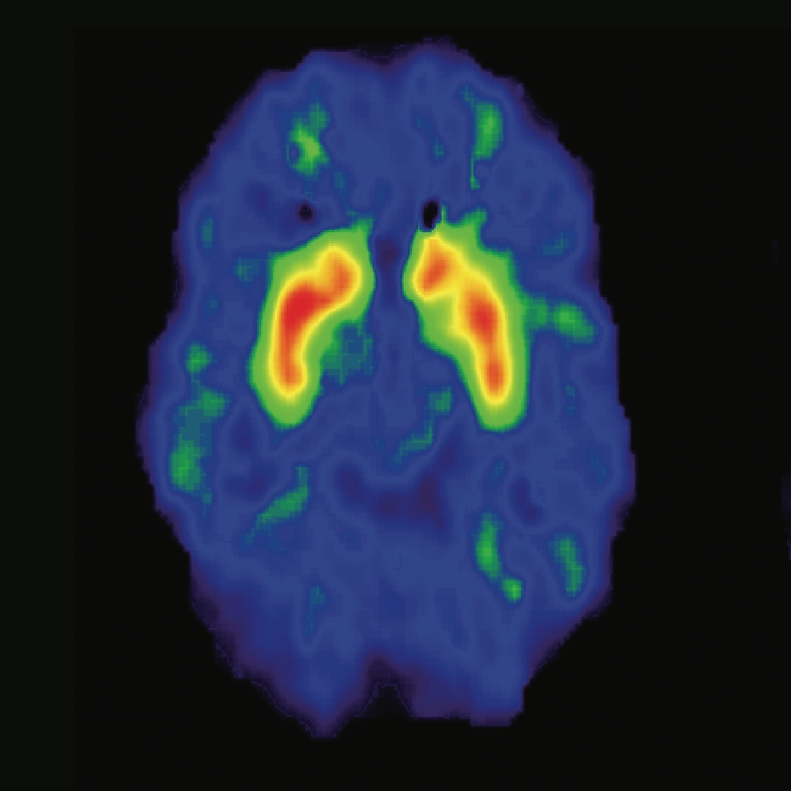
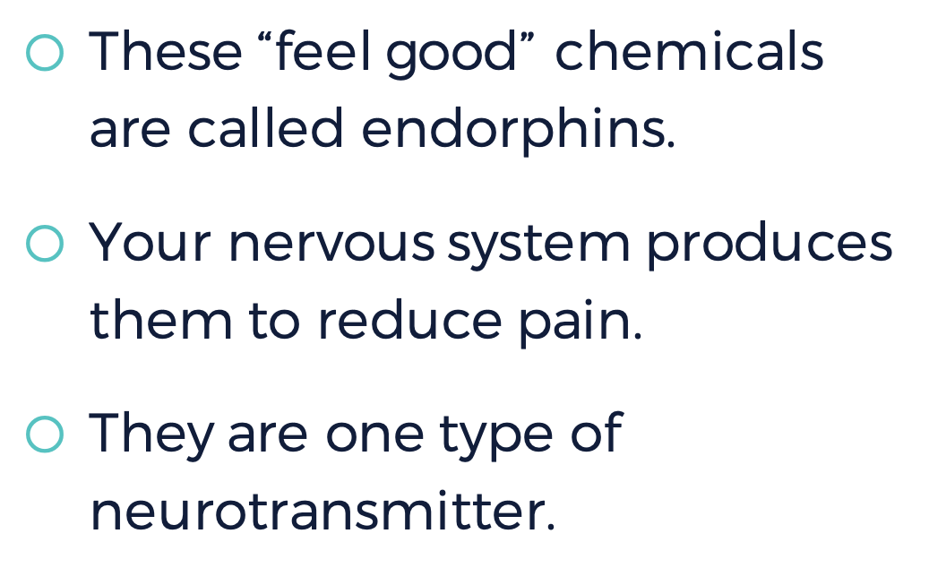

These “feel good” chemicals are called endorphins.
Your nervous system produces them to reduce pain.
They are one type of neurotransmitter.
Notes:
Instructor Notes: Click to reveal the image first, and discuss what students see and what they think is happening. Then, click to reveal the text and define endorphins.

Slide 3

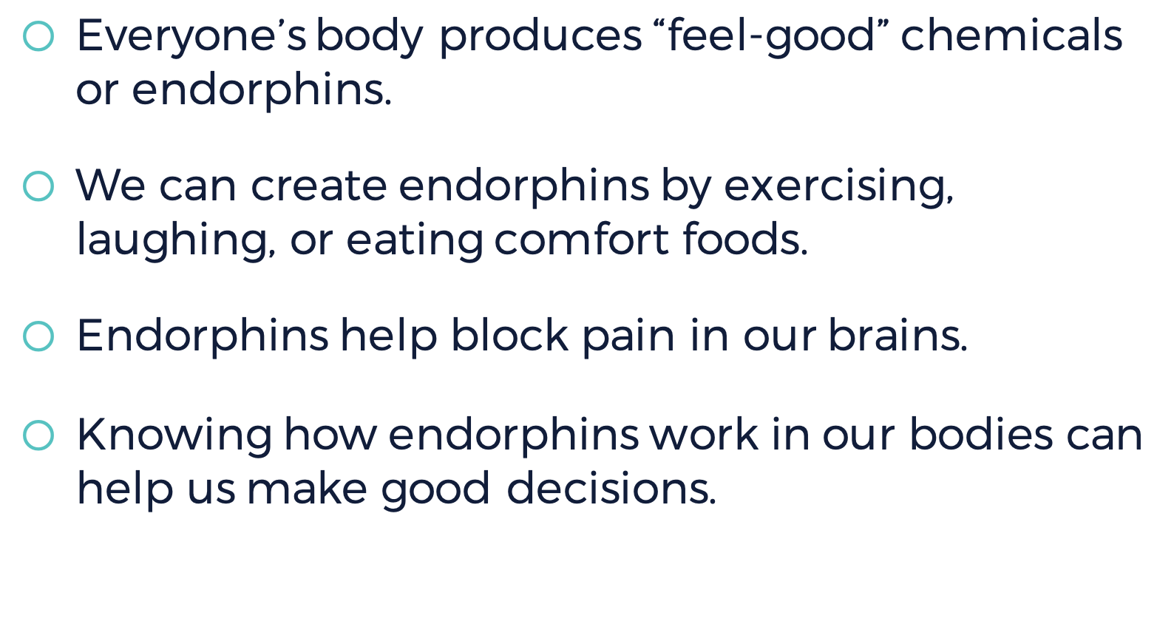

Everyone’s body produces “feel-good” chemicals or endorphins.
We can create endorphins by exercising, laughing, or eating comfort foods.
Endorphins help block pain in our brains.
Knowing how endorphins work in our bodies can help us make good decisions.

Slide 4


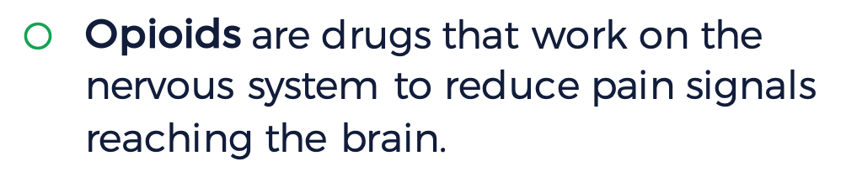
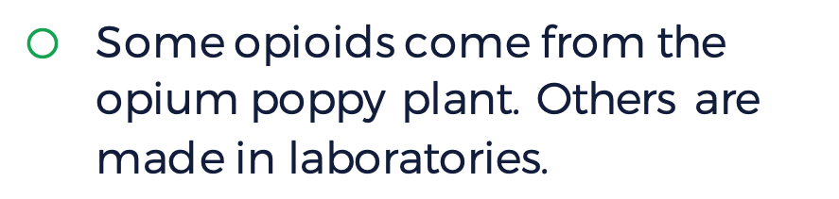
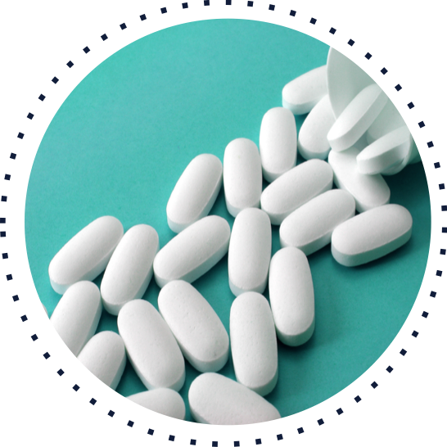
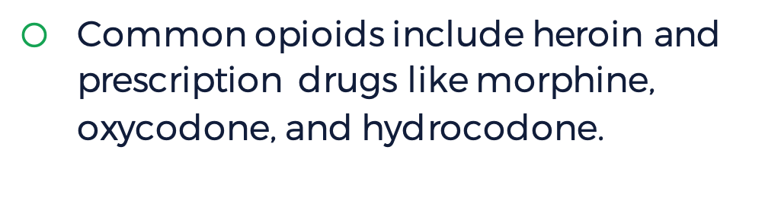

Opioids are drugs that work on the nervous system to reduce pain signals reaching the brain.
Some opioids come from the opium poppy plant. Others are made in laboratories.
Common opioids include heroin and prescription drugs like morphine, oxycodone, and hydrocodone.
Notes:
Instructor Notes: Click to reveal the image and then each bullet point of text, and discuss each with students before moving on to the next one.
When people take opioid drugs, they experience a euphoric rush because these drugs also affect the brain regions involved in reward. Some people may misuse opioids because they want to intensify their experience by taking the drug in ways other than those prescribed. Some people don’t use opioids to control pain. They use opioids because it gives them a relaxed, “high” feeling.

Slide 5




opioids
endorphins

Slide 6


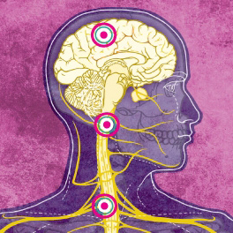



Notes:
Instructor Notes: In small groups, students should read the linked article, take notes on a separate sheet of paper, and then discuss the questions. As a whole class, share out small-group responses.

Slide 7


Opioid use affects us physically and can be harmful.
In order to be healthy, we need to understand and protect ourselves from the risks of opioid misuse.
Knowing how opioids work helps us to make better decisions for ourselves if we are prescribed them for pain or injury.

Slide 8

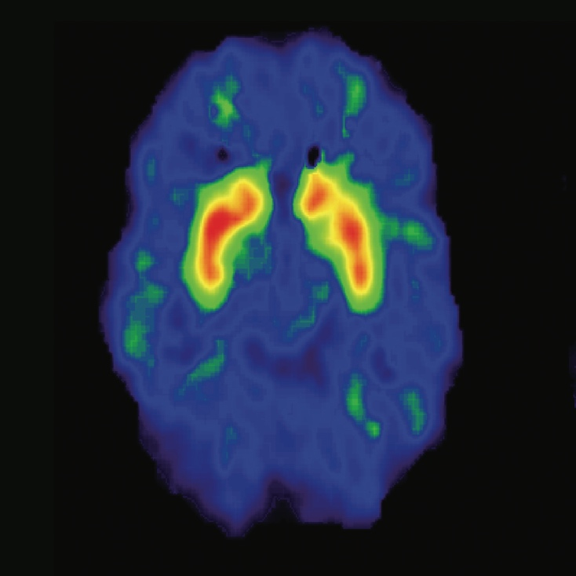
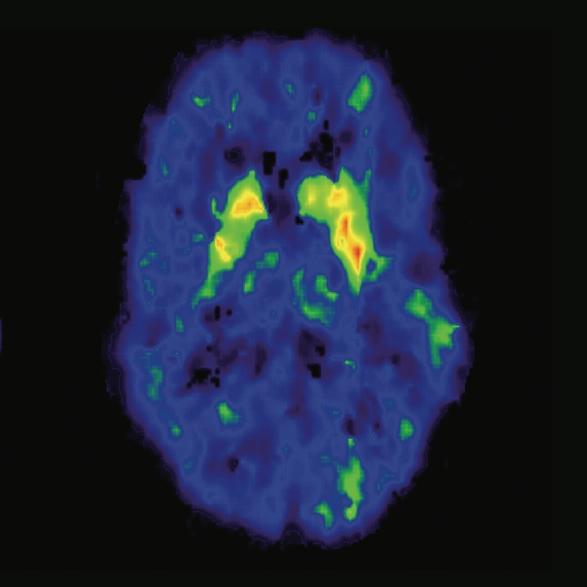


What questions do you have?
Notes:
Instructor Notes: As they view the image, students should note how the brains are different: the left side shows normal activation of the brain during a cognitive task. The right side shows brain activation with the influence of drugs. Activation is shown by color: red shows strongest activity, then orange, then yellow, then green. The image on the left shows strong activation in red and orange in the target area, while the image on the right shows much less and weaker activation, with only a little yellow and green.

Slide 9

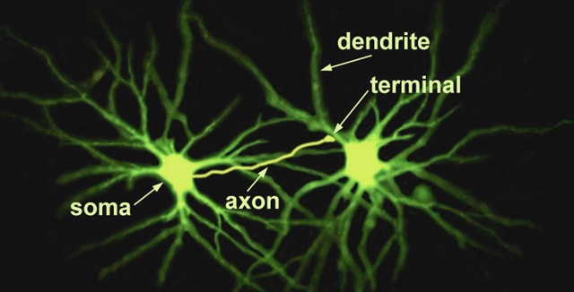

Notes:
Instructor Notes: Describe how neurons are composed of several parts: the soma (cell body), dendrites (branches), and an axon (fibers) leading to a terminal (bulb). Point to each part in the diagram. Make connections, or encourage students to do so, between their body parts in the previous model activity and the neuron. (The body is the soma, the arm is the axon, and their fingertips are the terminal.) Then, ask students to predict what each part of a neuron does.
Once students have had a chance to explore the image, explain the purpose of each part. The branches (dendrites) receive messages from neighboring neurons. The middle (soma) processes the information. It creates an electrical signal (a major impulse called the action potential) and sends it down the fiber (axon) toward the bulb at the tip (terminal); the signal can then be transferred to the dendrites of a neighboring neuron. Use your finger or the onscreen pointer to trace this movement on the slide.
It is more important for students to understand the purpose of the parts, and the direction that a message moves relative to each part, than to memorize the names of each part.

Slide 10

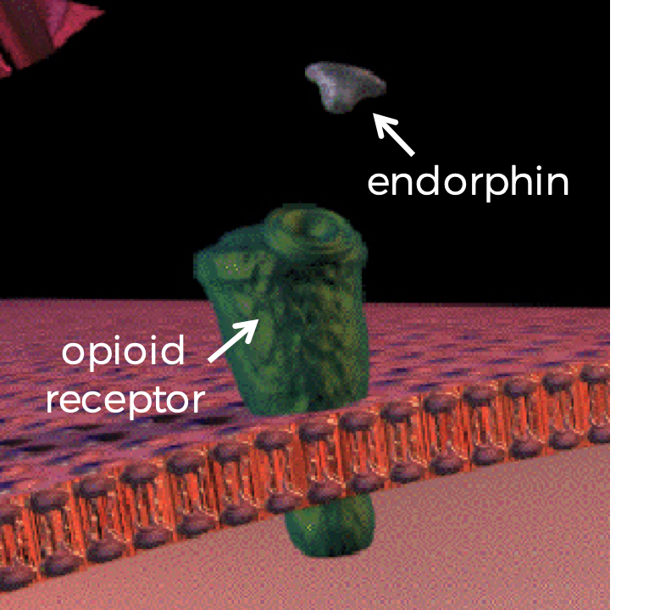
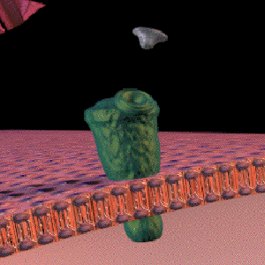
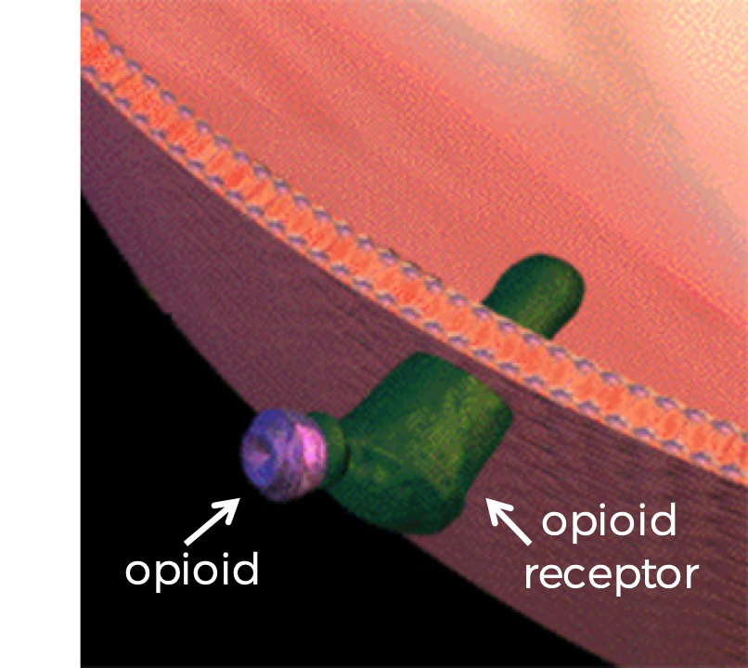
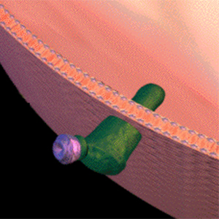
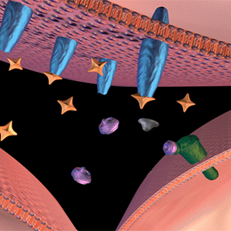


The brain cannot tell the difference!
endorphin
opioid receptor
opioid receptor
opioid
Notes:
Instructor Notes: Present students will this analogy: neurotransmitters are like “keys” that fit certain “locks” in the brain. Different keys fit different locks. Because the shapes of opioids and endorphins are similar, opioids are able to fit into “locks” intended for endorphins.
Click to display the images and ask students a series of questions to guide their inquiry:
What do you notice about the shape of each “key”—i.e., the natural endorphin and an opioid like morphine? (Circle the bottom section of each—i.e., the section that fits into the endorphin receptors. They are similar.)
The endorphin receptor is the “lock” from the analogy. What type of “lock” does each key fit into? (Both natural endorphins and opioid receptors fit into endorphin receptors.)
What conclusion can you draw from this relationship? (The brain cannot tell the difference between natural endorphins and opioids.)
After students have drawn their own conclusions, explain that opioids mimic the action of endorphins by fitting in the same locks (binding to endorphin receptor sites in the brain). This affects feelings of pain as well as a person’s overall emotional state. However, endorphins are not harmful or addictive like opioid drugs are. Endorphins come from positive activities such as exercising, laughing, and eating certain foods. Click the slide to display the text (“The brain cannot tell the difference!”).

Slide 11

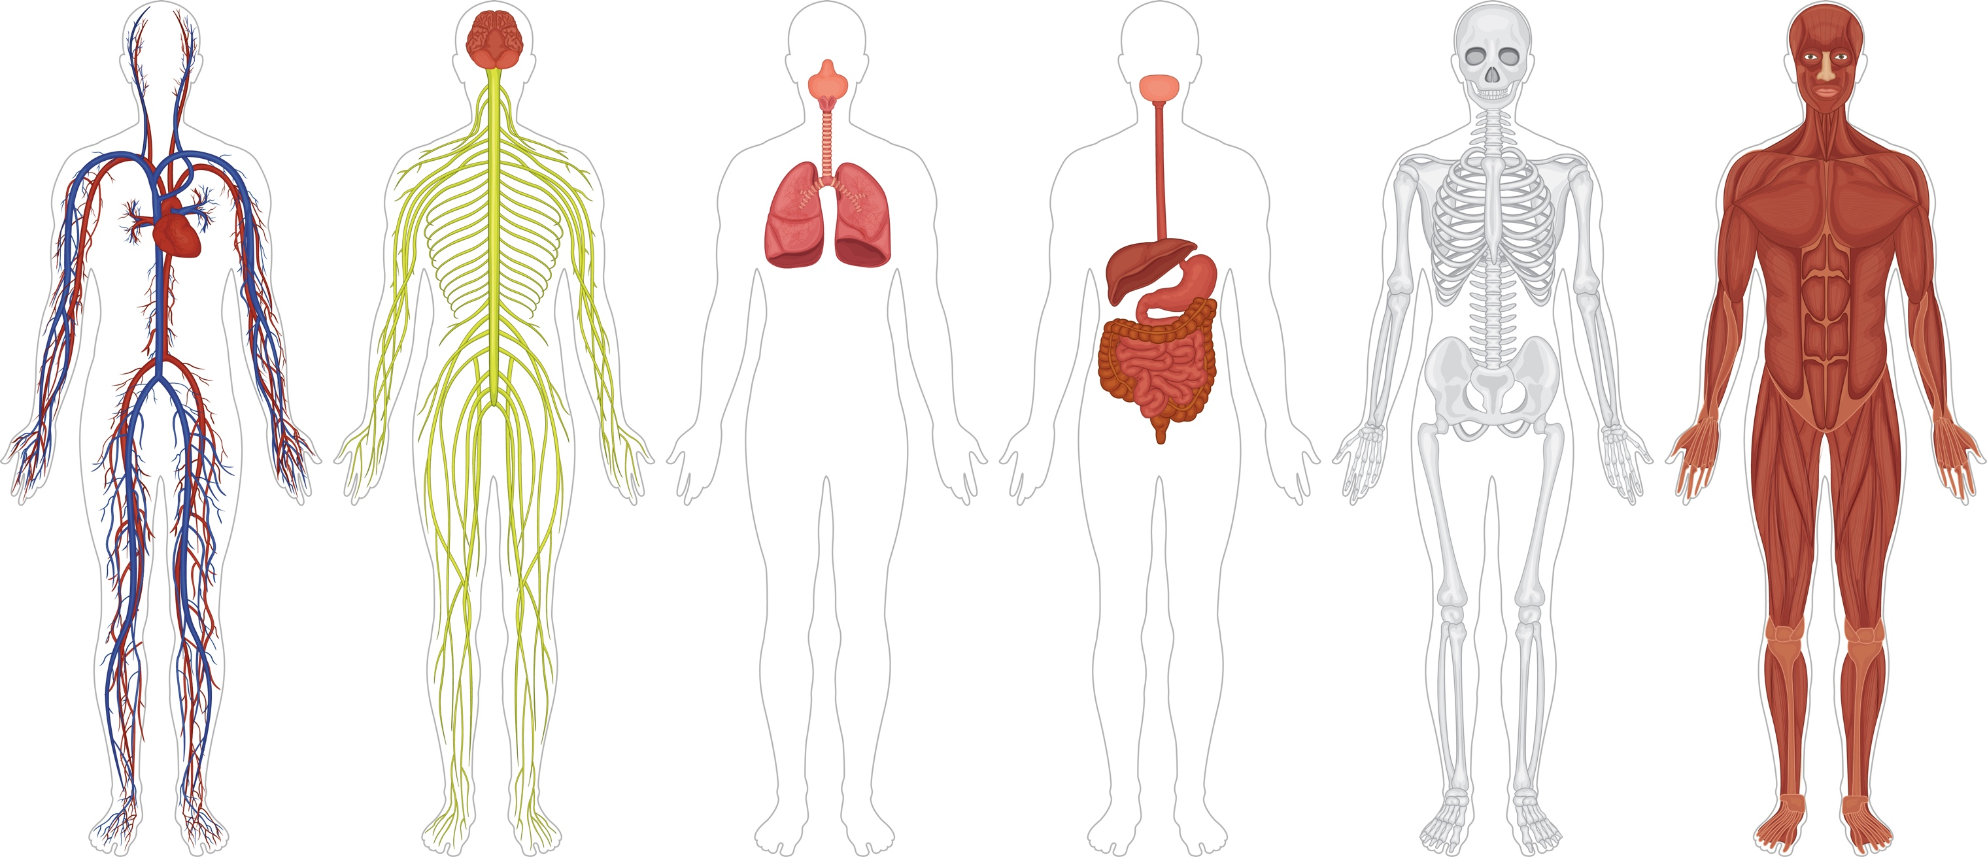







Circulatory
Nervous
Respiratory
Digestive
Skeletal
Muscular
Notes:
Instructor Notes: Display the images of the body systems before displaying the text labels. Ask students to reflect on how each body system functions in a healthy person. If time allows, each student should write a six-word description of each system.

Slide 12


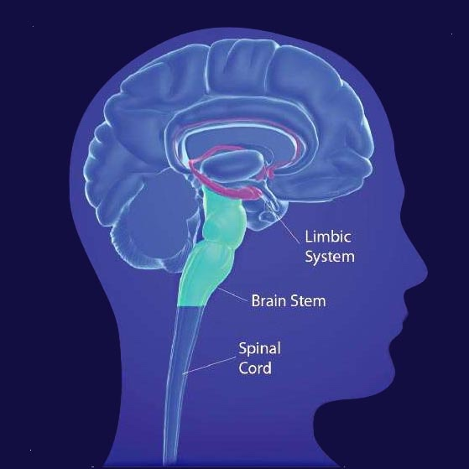










Dry mouth
Heavy feeling in fingers and toes
Vomiting
Severe itching
Notes:
Instructor Notes: Students should be able to identify the short-term effects on the nervous system (euphoria), circulatory system (slowed heart function), respiratory system (slowed breathing), digestive system (dry mouth, nausea, vomiting), muscular system (warm flushing of the skin, heavy feeling in fingers and toes, itching), and skeletal system (bone thinning). Connect these short-term effects to the brain and nervous system by interacting with the image and saying the following:
“Opioids can slow breathing by altering activity in the brainstem (point to this section), which controls automatic body functions such as breathing and heart rate.”
“Opioids can increase feelings of pleasure by altering activity in the limbic system (circle this system), which controls emotions.”
“Opioids can block pain messages transmitted through the spinal cord (draw an arrow up along this section) from the body.”

Slide 13

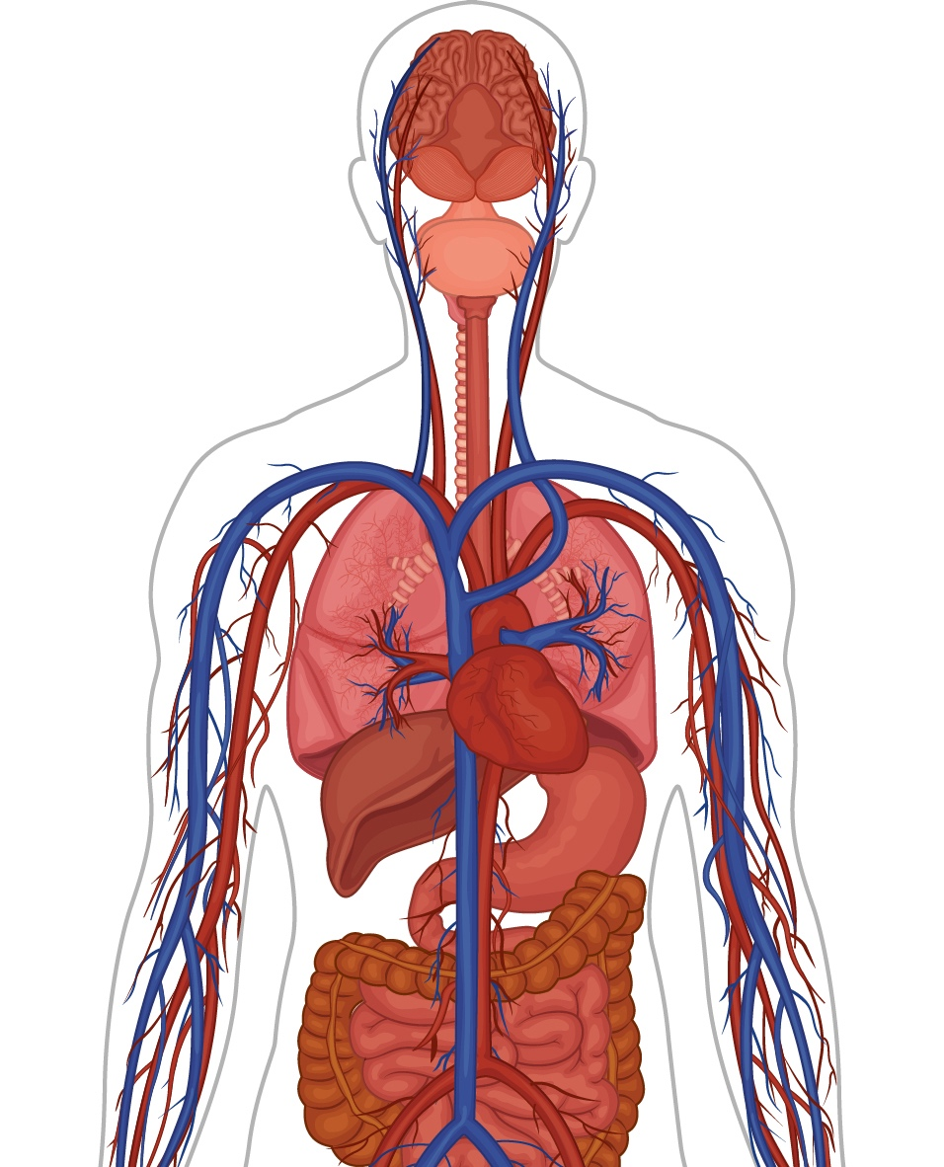














Nervous system
Integumentary system
Respiratory system
Circulatory system
Digestive system
Circulatory system
Notes:
Instructor Notes: Students should be able to identify the long-term effects on the circulatory system (infection of heart, collapsed veins), respiratory system (pneumonia), digestive system (decreased liver function), and nervous system (tolerance, dependence).

Slide 14

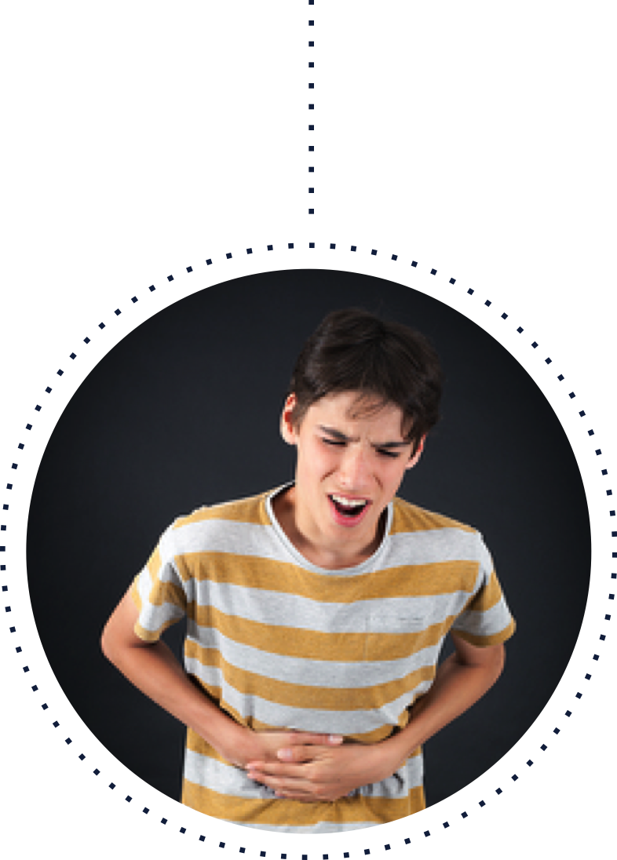
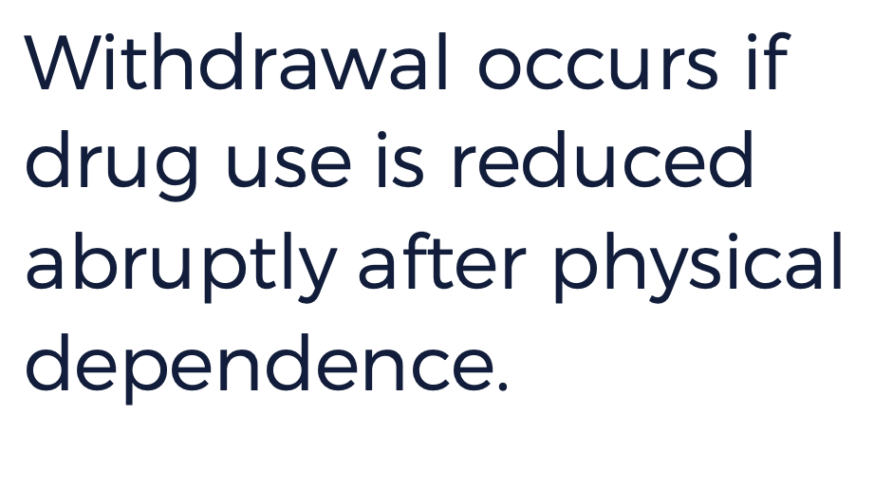
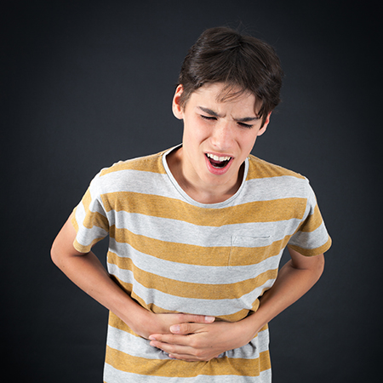
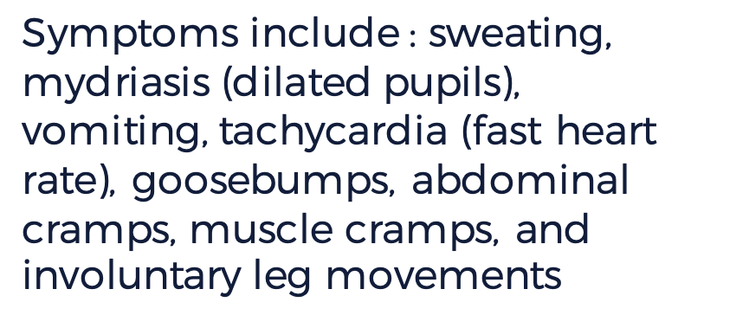

Symptoms include : sweating, mydriasis (dilated pupils), vomiting, tachycardia (fast heart rate), goosebumps, abdominal cramps, muscle cramps, and involuntary leg movements
Notes:
Instructor Notes: Ask students if they have any routines (like brushing their teeth every morning) and how their bodies would feel if this routine were interrupted. Click to display the definition of withdrawal. Then, click to display the image and ask students to describe what they see.

Slide 15


